Slide 1

Lesson 1.1 : Welcome to SNAP
Microsoft Philanthropies TEALS Program
Introduction to Computer Science

Slide 2
Welcome to SNAP!
After this lesson, you will be able to...
Define and identify "blocks," "scripts," "sprites," and "the stage" in SNAP!
Write simple SNAP! programs
Describe what simple SNAP! programs do without executing the code

Slide 3
Today’s Plan
Do Now
Lesson
Lab
Debrief

Slide 4

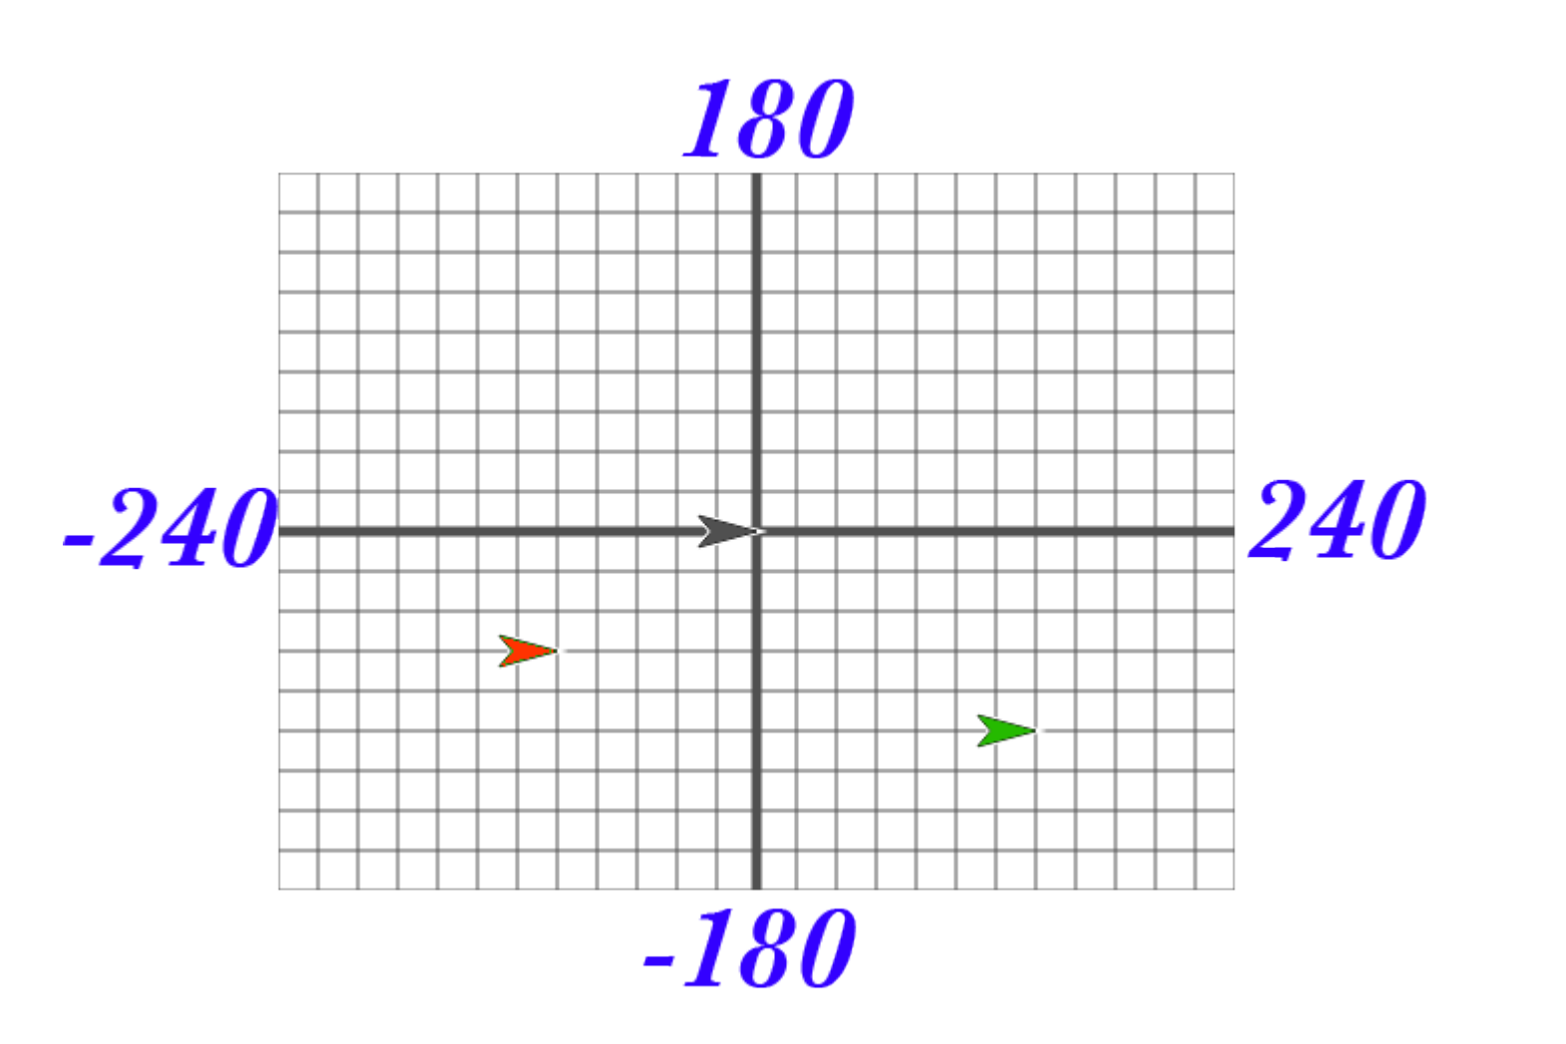
Do Now 1.1
In your notebook, answer the following,
What are the approximate coordinates of the red sprite?
What are the approximate coordinates of the green sprite?
In your SNAP! window, look at the blocks under the Motion tab. Most of the blocks there will help you position your sprite on the stage. Try them and see what they do! Change the input values to see what happens.
List at least 4 blocks from the Motion tab that will change the position of a sprite.

Slide 5

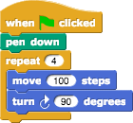
1.1 Lecture: Welcome to SNAP!
Notes:
https://tealsk12.gitbook.io/intro-cs/unit_1/lesson_11#instructors-notes
SNAP is a programming language, which you can use to tell a computer what to do. A program is a particular set of instructions for the computer to follow.
Programs in most languages use only letters (and punctuation), but SNAP is different: it's a visual language. Instead of writing a program only using the keyboard, you will drag pictures of blocks and click them together.
The following is a program in SNAP!, turn to a partner and talk about what you think this program does
(Take student answers)

Slide 6
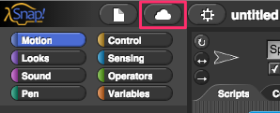
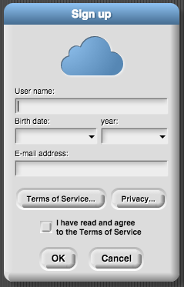
1.1 Lecture: Welcome to SNAP! Making an account
Notes:
https://tealsk12.gitbook.io/intro-cs/unit_1/lesson_11#instructors-notes
SNAP is different than many other languages in another way— you run it in a web browser like Firefox or Chrome.
(The URL that you can use to always get to SNAP! Is http://snap.berkeley.edu/run )
In order to save your programs, the first thing you'll need to do is make an account. In the SNAP browser window, Find the cloud-shaped button in the top toolbar on the upper left corner of the window:
Click it, select the "sign up" option in the menu, and follow the instructions there. You will need to check your email after creating your account to get your initial password.
(Give students a minute to set up their SNAP accounts.)

Slide 7
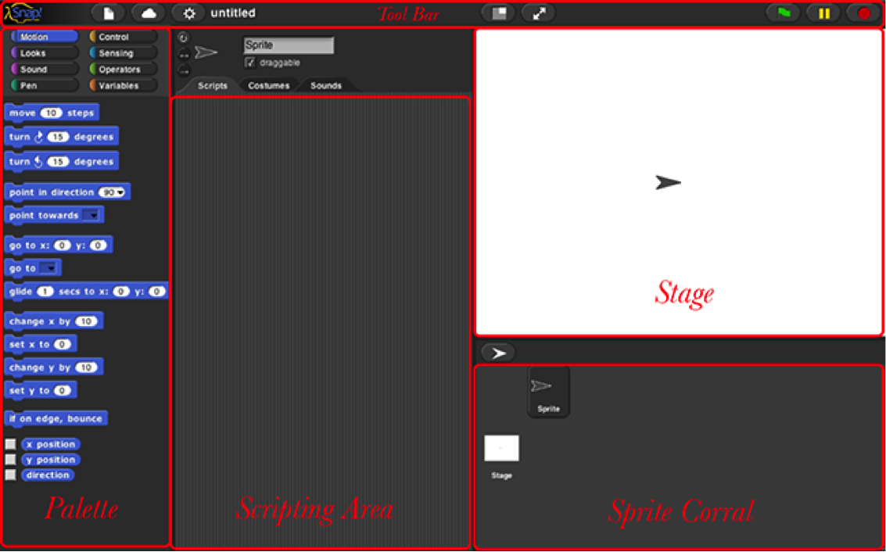
1.1 Lecture: Welcome to SNAP! (Continued)
Notes:
https://tealsk12.gitbook.io/intro-cs/unit_1/lesson_11#instructors-notes
You may have noticed that there are a few main sections of the SNAP! window. These regions are named as shown below.

Slide 8
1.1 Lecture: Welcome to SNAP! (Cont’d)
Notes:
https://tealsk12.gitbook.io/intro-cs/unit_1/lesson_11#instructors-notes
The area at the left edge of the window is the palette. As you see in the picture, it contains tabs for eight different-color block categories. In this lab, we will focus on the Motion, Sound, Pen, and Sensing tabs. You will learn about the other tabs in the next few labs.
These tabs are an important organizational structure in SNAP because they are home to the various blocks that you will use to tell the computer what to do. The blocks are categorized under each tab based on what kind of thing each block does.

Slide 9

Lab 1.1
In this lab you will explore how SNAP! Is organized and start learning the basics of how to create a program.
Notes:
https://tealsk12.gitbook.io/intro-cs/unit_1/lesson_11#instructors-notes
Individually or in pairs, have students continue working through the "Welcome to SNAP" lab activity.
If you choose to assign pairs, try to partner students into groups that are heterogenous by ability or background.
Try to pair students who do not normally interact.
Students should answer all questions and complete all activities and turn them in using your chosen turn-in procedure.
For written questions, either have students hand-write answers and turn in the hard copies or set up an electronic submission system of some kind.
For SNAP programs, including the Kaleidoscope program, students should save the program to the cloud and share a link with you
Students should aim to get through at least part 6 by the end of Day 1
Throughout the period, you can pause class to discuss each numbered part of the lab before moving on
Circulate while students are working and try to judge when the majority of the class has finished each part
Try to check in at least every 10 minutes

Slide 10
Lab 1.1 – Submitting Work
Notes:
https://tealsk12.gitbook.io/intro-cs/unit_1/lesson_11#instructors-notes
Demonstrate the turn-in procedure you will use for student work throughout the semester, and have students follow along to turn in their work from the lab.
Ensure that each student is able to turn in their work before the class period ends.

Slide 11

Debrief
Notes:
END OF DAY 2
https://tealsk12.gitbook.io/intro-cs/unit_1/lesson_11#instructors-notes
Discuss the challenges in the Kaleidoscope program
Ask students how the challenges were similar to or different from those they encountered when playing LightBot in Lesson 0.2
If time allows, ask one or two students to demonstrate their programs and describe their code
Remind students of the turn-in procedures discussed yesterday and ensure all students are able to turn in their work

Slide 12

Exit Ticket
In your notebook, Write down two things you learned today.

